Slide 1
Hybrid AF Therapy
EPi-Sense® Guided Coagulation System
EU Indications: The EPi-Sense® Guided Coagulation System with VisiTrax® is intended for the coagulation of cardiac tissue using radiofrequency (RF) energy during cardiac surgery for the treatment of arrhythmias including Atrial Fibrillation (AFIB) or Atrial Flutter (AFL). Contraindications include patients with Barrett’s Esophagitis, left atrial thrombus, a systemic infection, active endocarditis, or a localized infection at the surgical site at the time of surgery. Reported adverse events associated with epicardial ablation procedure may include, but are not limited to, the following: pericardial effusion, excessive bleeding, Pericarditis, phrenic nerve injury, stroke/TIA/neurologic complication.
Please review the Instructions for Use for a complete listing of contraindications, warnings, precautions and potential adverse events located at the following AtriCure web address: https://www.atricure.com/instructions-for-use/international
PM-EU-1681B-0624-G

Slide 2

Hybrid epicardial-endocardial ablation vs. endocardial catheter ablation for long-standing persistent atrial fibrillation treatment: A sub-analysis from CONVERGE multi-center randomized controlled trial
David B. DeLurgio, MD
Director of Electrophysiology, Emory St Joseph’s Hospital
Global Principal Investigator for CONVERGE IDE study
ddelurg@emory.edu
PM-EU-1681B-0624-G

Slide 3
Disclosures
Consulting and Speakers Bureau for AtriCure, Inc.
Consulting and Speakers Bureau for Boston Scientific
Consulting for Medtronic
Disclaimer:
The CONVERGE trial was funded by AtriCure, Inc.
Reference materials were requested and obtained from AtriCure, Inc for portions of this presentation.
AtriCure Epi-Sense system is 510(k) cleared for coagulation of cardiac tissue.
PM-EU-1681B-0624-G

Slide 4
Advanced AF: Characterized by changes to LA substrate
While PV triggers are predominant earlier in the development of AF, there is an increased involvement of the atrium as the disease progresses.
Mechanical stress on the atrium due to pericardial tethers and cardiac motion causes stress induced inflammation and fibrosis, especially in posterior left atrium.
Atrial fibrosis is a key factor in the genesis and/or perpetuation of AF.
Addressing progressive nature of AF and fibrosis during ablation may yield improved outcomes.
Yang et al. J Atr Fibrillation. 2017 Oct-Nov; 10(3): 1627
Cochet H, et al. J Cardiovasc Electrophysiol 2015;26:484-92
PM-EU-1681B-0624-G
Notes:
As AF progress, a higher proportion of patients tend to have extra-PV drivers.

Slide 5
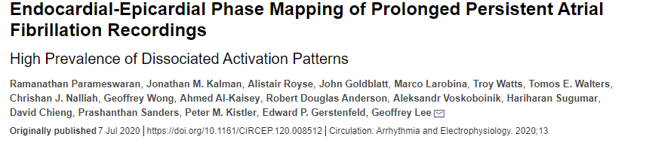
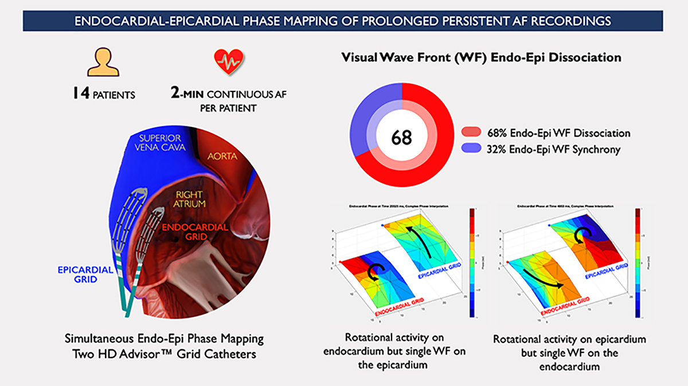
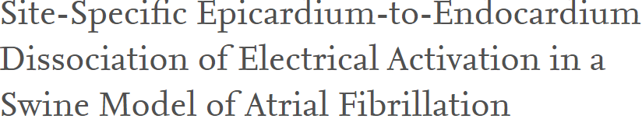
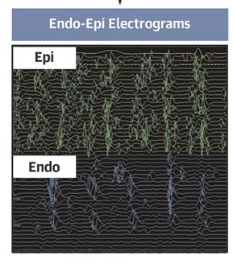
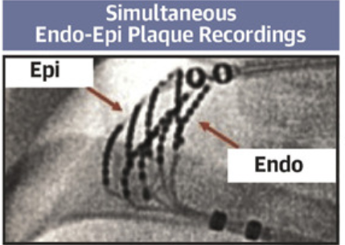
Endocardial-epicardial dissociation
50.3% Endo-Epi dissociation with significant temporal heterogeneity
Simultaneous endo-epi phase mapping in persistent AF shows significant endocardial-epicardial dissociation and unstable wavefront propagation patters transitioning between endocardial and epicardial surfaces.
Due to complex 3D wave propagation phenomenon, endocardial mapping alone cannot fully characterize the AF mechanism and endocardial ablation alone may not be sufficient.
Parameswaran et al. Circ Arrhythm Electrophysiol. 2020;13:e008512
Aronis and Trayanova. Circ Arrhythm Electrophysiol. 2020;13
Nazaroam et a; JACC EP Volume 6, Issue , 2020
PM-EU-1681B-0624-G
Notes:
As AF progress, a higher proportion of patients tend to have extra-PV drivers.

Slide 6
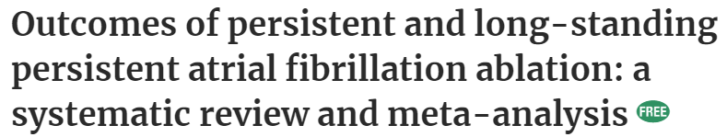
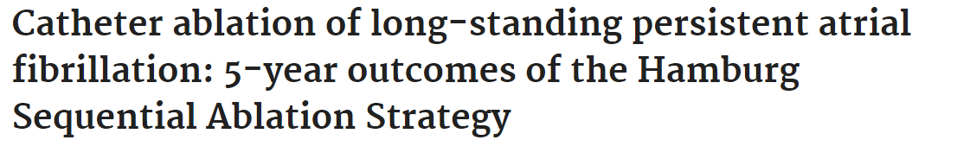
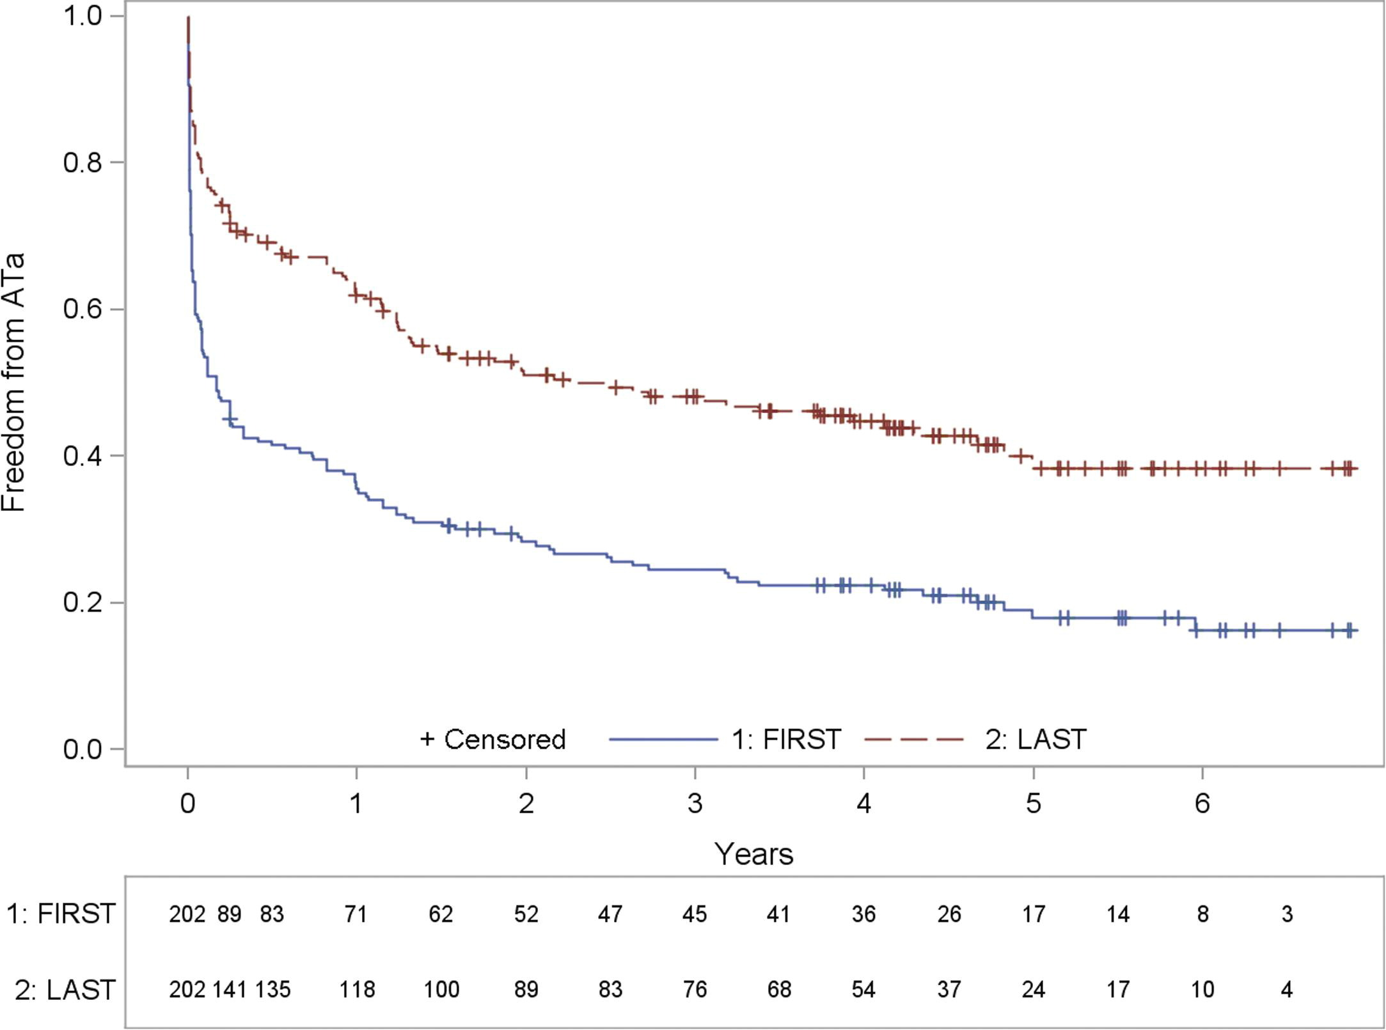
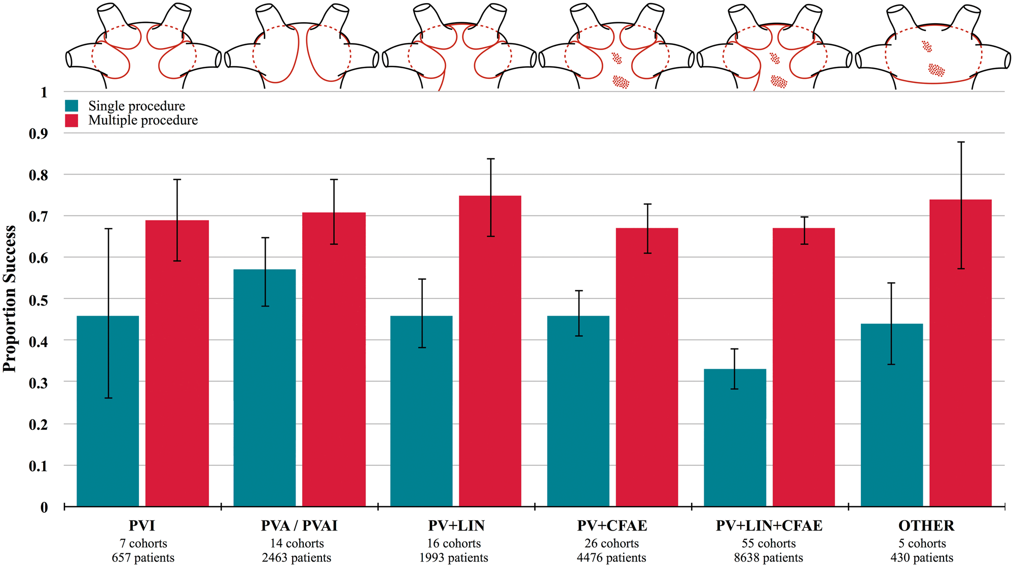
Advanced AF: Not easily addressed by endocardial ablation alone
Clarnette et al Europace 2018
Tilz et al JACC 2012
12-mo single-procedure success : 35.6%
Single-procedure success : 43% (95% CI; 39–47%)
Lack of a standardized lesion set, challenges of achieving transmural lesions, and the phenomenon of endocardial-epicardial dissociation in AF together contribute to limited effectiveness of endocardial ablation alone
PM-EU-1681B-0624-G
Notes:
Specifically in long-standing persistent AF patients (LSPAF), clinical success with endocardial only ablation is marginal.

Slide 7
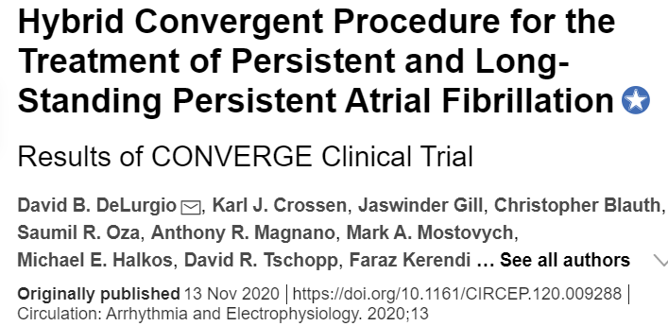
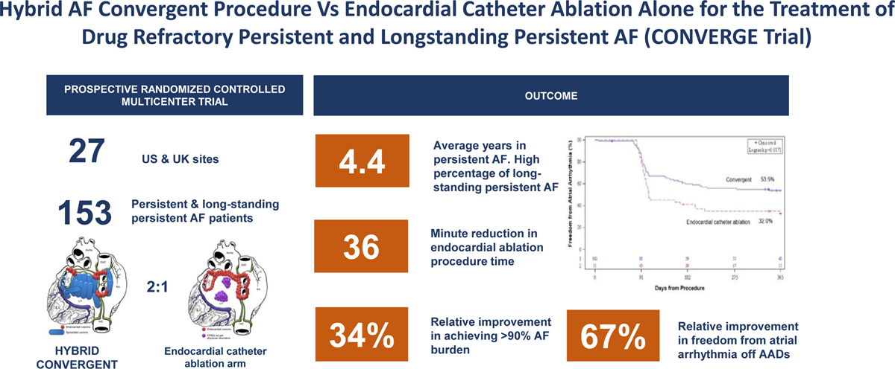
Hybrid Convergent Procedure and CONVERGE Clinical Trial
The hybrid Convergent procedure combines endocardial and epicardial ablation to achieve a more comprehensive PV and extra- PV substrate ablation with transmural lesions while minimizing the risk of esophageal injury.
The epicardial ablation is conducted by a cardiothoracic surgeon via sub-xyphoid or trans-diaphragmatic access to the pericardium and the endocardial procedure is conducted by electrophysiologist in standard fashion.
CONVERGE clinical trial demonstrated that hybrid Convergent procedure has acceptable safety profile and superior effectiveness compared to endocardial ablation alone in patients with persistent and long-standing persistent AF.
DeLurgio et al Circulation: Arrhythmia and Electrophysiology. 2020;13
PM-EU-1681B-0624-G

Slide 8
Long-standing persistent AF sub-analysis
The CONVERGE trial imposed no limits on the duration of AF and allowed patients with substantial left atrial dilation, making it the only ablation trial to include a substantial portion of patients with long-standing persistent AF and with significant co-morbid conditions.
A total of 42% patients in the trial had long-standing persistent AF
A sub-analysis was conducted to determine the outcome of hybrid Convergent procedure when compared to endocardial catheter ablation alone for the treatment of long-standing persistent AF:
  Primary effectiveness: Freedom from atrial arrhythmia through 12 months absent new/increased dose of previously failed anti-arrhythmic drugs (AADs).
  Primary safety: Major adverse event rate through 30 days in hybrid Convergent arm
  Secondary outcomes: Freedom from AF, >90% AF burden reduction, AF symptom and 18 month effectiveness (using 7-day holter).
PM-EU-1681B-0624-G

Slide 9
Baseline Characteristics and Procedural Parameters
Parameter | Hybrid Convergent (N=38) | Endocardial Ablation alone (N=27)
Age (mean) | 61.5 yrs | 65.2 yrs
Male | 82% | 56%
BMI | 32.7 | 35.4
Left atrial size (mean) | 4.5 cm | 4.3 cm
AF duration (mean) | 6.0 yrs | 5.9 yrs
Patients with cardioversion within previous 12 months | 53% | 59%
Epicardial ablation time (mean) | 77 minutes | Not applicable
Endocardial ablation time (mean) | 140 minutes | 180 minutes
PM-EU-1681B-0624-G

Slide 10
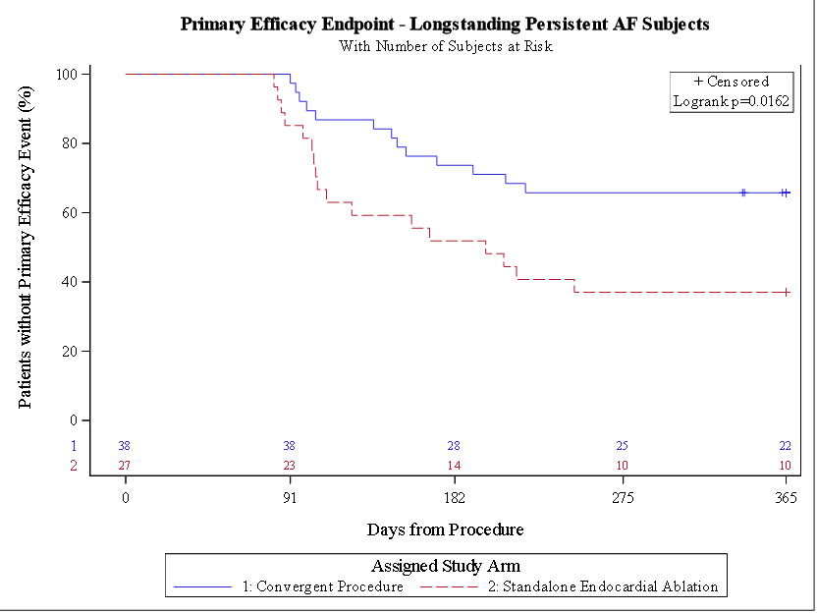
Primary effectiveness through 12 months
65.8%
The absolute difference of 28.8% (78% improvement) is statistically significant (p=0.022) in favor of the hybrid Convergent procedure*
*Based on post-hoc analysis
37.0%
PM-EU-1681B-0624-G

Slide 11
Freedom from atrial arrhythmia by AAD Use
12 months and 18 months
Freedom from atrial arrhythmia with and/or without AADs was significantly higher with hybrid Convergent Vs endocardial ablation alone, and sustained through 18 months (7-day holter)
PM-EU-1681B-0624-G

Slide 12
Freedom from AF and AF Burden Reduction
12 months and 18 months
Freedom from AF and >90% reduction in AF burden was significantly higher with hybrid Convergent Vs endocardial ablation alone, and sustained through 18 months (7-day holter)
PM-EU-1681B-0624-G

Slide 13
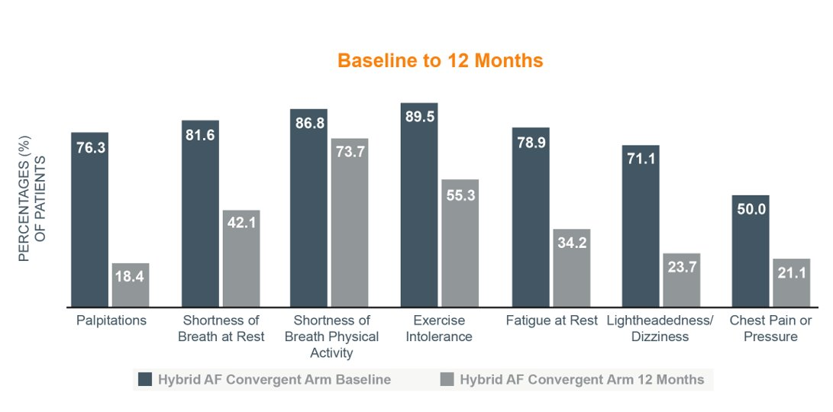
Freedom from Cardioversion and AF Symptoms Improvement
A total of 71% hybrid Convergent patients Vs 41% endocardial ablation patients (p = 0.015) had freedom from cardioversion from procedure through 12 months
Both study arms demonstrated improvement in AF symptoms as compared to baseline.
AF symptoms reduction in hybrid Convergent arm from Baseline to 12 months
PM-EU-1681B-0624-G

Slide 14
Safety
No deaths, cardiac perforation or AE fistula were reported in either study arms.
The safety rate in hybrid Convergent arm was 7.9%.
  One pericardial effusion: delayed effusion due to inflammatory response to pericardiotomy and ablation, resolved after pericardial fluid drainage
  One stroke
  One phrenic nerve injury (resolved)
These pre-specified primary safety events were not reported in the endocardial ablation arm.
PM-EU-1681B-0624-G

Slide 15
Conclusion
Superior outcomes with hybrid Convergent procedure when compared to endocardial catheter ablation alone in patients with drug refractory long-standing persistent AF.
The results sustained with multiple definition of success and through 18 months.
Significant reduction in AF symptoms reported by patients.
Acceptable safety profile.
Improved EP lab efficiency as demonstrated by 41 minutes reduction in endocardial ablation time as a result of adding epicardial ablation.
A collaborative heart team approach helps improve outcomes in difficult to treat patients with advanced AF.
PM-EU-1681B-0624-G

Slide 16
Study Investigators
David B DeLurgio, MD and Michael Halkos, MD : Emory University - St. Joseph's Hospital Atlanta, Georgia
Karl Crossen, MD and Edward Ferguson : Cardiology Associates Research, LLC Tupelo, Mississippi
Jaswinder Gill, MD and Christopher Blauth, MD: Guy's and St. Thomas Hospital, London, UK
Saumil Oza, MD, Anthony Magnano, MD, Mark Mastovych, MD: St. Vincent's HealthCare Jacksonville, Florida
David Tschopp, MD and Faraz Kerendi, MD : Austin Heart PLLC Austin, Texas
Tyler Taigen, MD , Eric Espinal, MD, Otto Constantini: Summa Health System Akron, Ohio
Christian Shults, MD and Manish Shah, MD: Medstar Washington Hospital Center Washington, District of Columbia
Jose Osorio, MD, Anil Rajendra, MD and John Casterline, MD: Grandview Medical Center Birmingham, Alabama
Jonathan S. Silver, MD and Bruce Hook, MD, Torin Fitton, MD: Lahey Clinic, Burlington, Massachusetts
David Gilligan, MD and Graham Bundy, MD: Virginia Cardiovascular Specialists, Richmond, Virginia
Sreedhar Billakanty, MD and Steven Duff, MD Riverside Hospital / OhioHealth, Columbus, Ohio
Paul B Tabereaux, Shaf B. Holden, MD Heart Center Research LLC, Huntsville, Alabama
Jason Sperling, MD, Christopher Stees, DO, Medical Center of Aurora, Samuel Aznaurov, MD Denver, Colorado
Felix Yang, MD, Yisachar Jesse Greenberg, MD and Isreal Jacobowitz, MD- Maimonides Medical Center, Brooklyn, NY
Michael Link, MD and Nikhil Jaik , MD UPMC Pinnacle Hospitals, Harrisburg PA
David Pederson, MD and James Richard Garrison, MD STAR Clinical Trials LLC
Syed Ahsan, MD and John Yap, MD St. Bartholomew's Hospital, London, UK
Kenneth Civello, MD and William Boedefeld, II, MD Cardiovascular Research Foundation of Louisiana, Baton Rouge, Louisiana
Pavlo Netrebko, MD and Byron Boulton, MD Wake Medical Center / Cary Research Group, Raleigh, North Carolina
Marc Silver, MD and Mathew Ebinger, MD, Genesys Regional Medical Center, Grand Blanc, Michigan
Jeff Olson, MD and Peter A. Walts, MD St. Vincent Medical Group Inc, Indianapolis, Indiana
David Weisman, MD and Neil Galindez, MD , Palm Beach Gardens Medical Center, Palm Beach Gardens, Florida
Angelo LaPietra, MD and Luis Rechani, MD Mt Sinai Medical Center, Miami Beach, Florida
Marcin Kowalski, MD and Alexander Wohler, MD Staten Island University Hospital, Staten Island, New York
Aditi Naniwadekar, MD and L. Wiley Nifong. MD East Carolina University - Vidant Medical Center, Greenville, North Carolina
Amit Thosani, MD, Allegheny-Singer Research Institute, Pittsburgh, Pennsylvania
Mani Daneshmand, MD, Duke University Medical Center, Durham, North Carolina
PM-EU-1681B-0624-G

