Slide 1
Hybrid AF™ Therapy Media Kit—Social Media for Hospitals
This document provides proposed social copy and creative assets for Facebook and Twitter to help you boost your social media presence online and bring awareness to Afib and Hybrid AF Therapy as a treatment option. Please use this copy to start conversations for your hospital / practice.

Slide 2
Hybrid AF™ Therapy Approach
TWITTER COPY:
A recent landmark study showed that Hybrid AF™ Therapy is effective for long-standing persistent Afib patients and is now available at [HOSPITAL NAME]. Learn more about the treatment and ask your physician if it might benefit you. [LINK] #HybridAF
FACEBOOK COPY:
A recent landmark study showed that Hybrid AF™ Therapy for advanced atrial fibrillation is effective for those with long-standing persistent Afib and is now available to treat patients at [HOSPITAL NAME]. Learn more about the treatment and ask your physician if it might benefit you. [LINK] #HybridAF
Link: Hybrid AF™ Therapy info on hospital website
Patient Animation
Right click, choose “Save Media As” to save graphic locally to use with post, or download from our media library.
Patient Animation Clip (2:39-3:18 “What Is Hybrid AF?”)

Slide 3
Hybrid AF™ Therapy Reason
TWITTER COPY:
1 in 4 adults over the age of 40 will develop #Afib; now new treatment options may help. Hybrid™ AF Therapy is 2x more effective than RF catheter ablation alone for long-standing persistent Afib patients. Learn more about Afib treatment options available.[LINK] #HybridAF
FACEBOOK COPY:
1 in 4 adults over the age of 40 will develop atrial fibrillation in their lifetime. Now options for #Afib treatment are expanding. Hybrid AF™ Therapy is one option for those with long-standing persistent Afib and is shown to be 2x more effective than RF catheter ablation alone.
Hybrid AF therapy is now available at [HOSPITAL NAME]. Ask your physician what treatment options are right to treat your AF. [LINK]
Link: Hybrid AF™ Therapy info on hospital website
IMAGE:
Right click, choose “Save as Picture” to save graphic locally to use with post, or download from our media library.
GRAPHIC showing 1 in 4 people will develop Afib; also show 2x more likely to be off rhythm control medications 1 year after procedure.

Slide 4
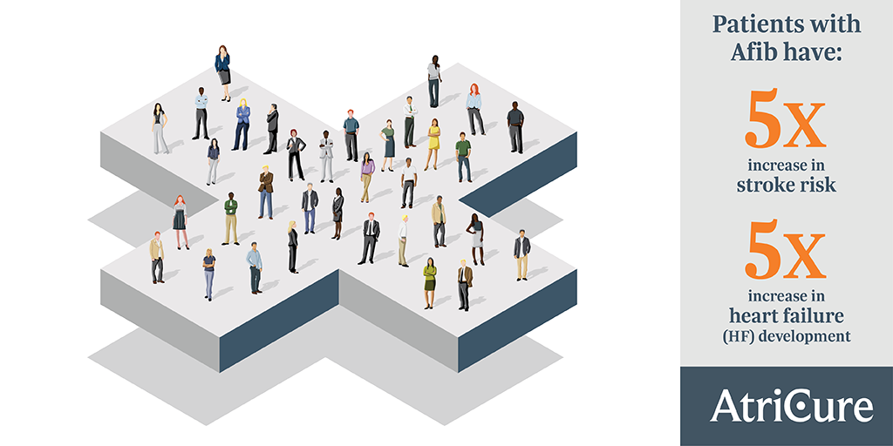
AF Burden Reduction
TWITTER COPY:
Patients with atrial fibrillation have a 5x higher risk of stroke and heart failure. Talk with your physician about new options now offered to treat #Afib, including #HybridAF Therapy for long-standing persistent Afib patients. Learn more: [LINK]
FACEBOOK COPY:
Patients with atrial fibrillation have a 5x higher risk of stroke and heart failure. Talk with your physician about new options now offered to treat #Afib, including #HybridAF Therapy for long-standing persistent Afib patients. Learn more: [LINK]
Link: Hybrid AF™ Therapy info on hospital website
IMAGE:
Right click, choose “Save as Picture” to save graphic locally to use with post, or download from our media library.
GRAPHIC with 5x stroke risk, 5x heart failure development (reused from Why Treat)

Slide 5
First Case of Hybrid AF™ Therapy
TWITTER COPY:
Congrats to our team on the first case! Hybrid AF™ Therapy treats the heart on the outside and inside, creating a more effective barrier to block the erratic electrical signals that cause long-standing persistent #Afib. Learn more: [LINK] #HybridAF
FACEBOOK COPY:
The [HOSPITAL NAME/HEART TEAM NAME] is leading the way in innovative treatments for patients with long-standing persistent atrial fibrillation. Hybrid AF™ Therapy treats heart tissue on the outside and inside and of the heart, creating a more effective barrier to block the erratic electrical signals of #Afib. Way to go [DOCTOR NAME] and team on the first case! Learn more: [LINK]
Link: Hybrid AF™ Therapy info on hospital website
IMAGE:
Right click, choose “Save as Picture” to save graphic locally to use with post, or download from our media library.
Suggested Image:
Take group photo with physician and case team.

Slide 6
New Case of Hybrid AF™ Therapy
TWITTER COPY:
Hybrid AF™ Therapy treats the outside and inside of the heart, creating a more effective barrier to block the erratic electrical signals that cause long-standing persistent #Afib. Congrats to our team on another case! Learn more: [LINK] #HybridAF
FACEBOOK COPY:
Today, Dr. [NAME] and the [HEART TEAM NAME] team performed another Hybrid AF™ Therapy case to treat a patient with long-standing persistent atrial fibrillation at [MEDICAL CENTER].
Hybrid AF Therapy combines both epicardial (outside) and endocardial (inside) ablation to treat atrial fibrillation.
The recent Hybrid AF CONVERGE Trial showed patients are 2x more likely to no longer need #Afib medication then when treated with RF catheter ablation alone.
Link: Hybrid AF™ Therapy info on hospital website
IMAGE:
Right click, choose “Save as Picture” to save graphic locally to use with post, or download from our media library.
Suggested Image:
Take group photo with physician and case team.

