Slide 1
Hybrid AF™ Therapy Media Kit—Social Media for Hospitals
This document provides proposed social copy and creative assets for Facebook and X/Twitter to help you boost your social media presence online and bring awareness to Atrial Fibrillation and Hybrid AF Therapy as a treatment option. Please use this copy to start conversations for your hospital / practice.
Updated 02/26/2024
PM-EU-1682C-0326-G

Slide 2
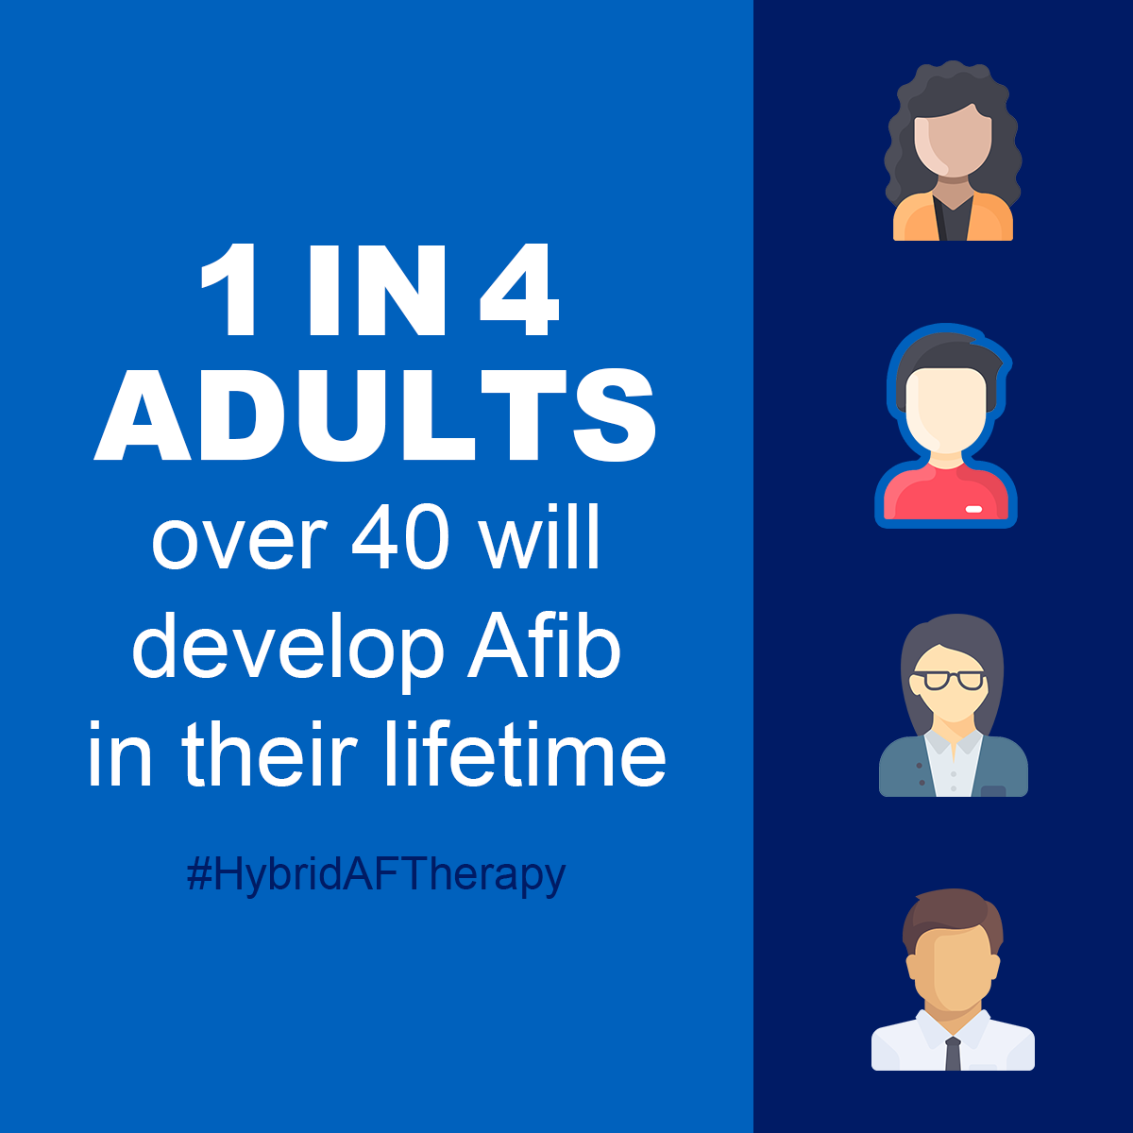
Hybrid AF™ Therapy Reason
TWITTER COPY:
1 in 4 adults over the age of 40 will develop AF. Luckily, treatment options are expanding. We’re proud to offer #HybridAFTherapy for advanced AF. Learn more about AF treatments. [HOSPITAL LINK]
FACEBOOK COPY:
1 in 4 adults over the age of 40 will develop AF in their lifetime. Luckily, treatment options are expanding. We’re proud to offer Hybrid AF™ Therapy for advanced AF.
Ask your physician what treatment options are right for you. [HOSPITAL LINK]
IMAGE:
Right click, choose “Save as Picture” to save graphic locally to use with post, or download from our media library.

Slide 3
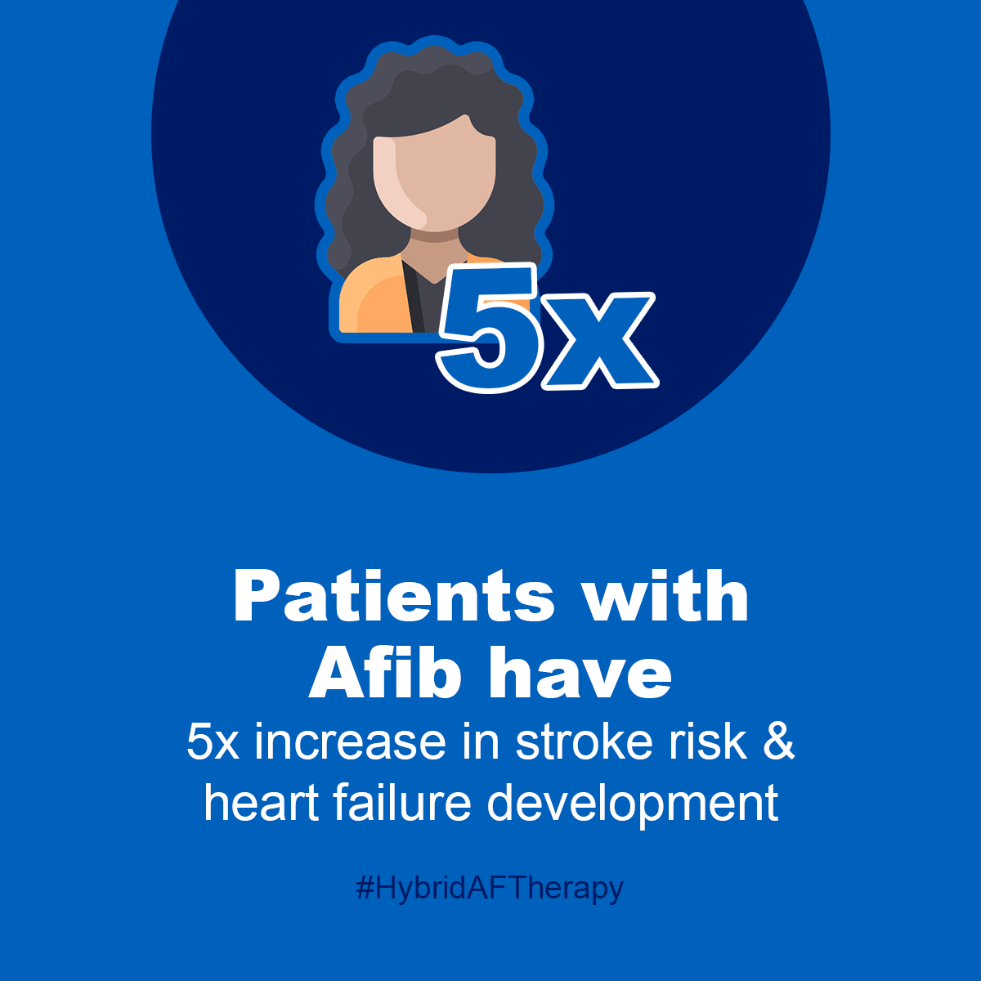
AF Burden Reduction
TWITTER COPY:
Patients with atrial fibrillation have a 5X higher risk of stroke and heart failure. Talk with your physician about treatment options for AF, including #HybridAFTherapy for advanced AF patients. Learn more: [HOSPITAL LINK]
FACEBOOK COPY:
Patients with AF have a 5X higher risk of stroke and heart failure development. Talk with your physician about treatment options, including Hybrid AF™ Therapy for advanced AF patients. Learn more: [HOSPITAL LINK]
IMAGE:
Right click, choose “Save as Picture” to save graphic locally to use with post, or download from our media library.

Slide 4
Complex forms of AF
TWITTER COPY:
We now have a better way to manage the million patients with complex forms of AF. #HybridAFTherapy uses ablations on the inside and outside of the heart to help patients achieve normal sinus rhythm. [HOSPITAL LINK]
Find out more: https://bit.ly/3QsLpwr
FACEBOOK COPY:
We now have a better way to manage the million patients with complex forms of AF. Hybrid AF™ Therapy includes ablations on the inside and outside the heart to help patients achieve normal sinus rhythm. [HOSPITAL LINK]
Find out more: https://bit.ly/3QsLpwr
Creative Recommendation:
We recommend asking a member from the Cardiac Team to do a quick “interview” video talking about what Hybrid AF Therapy is.

Slide 5
Another Option
TWITTER COPY:
For AF patients who have tried catheter ablations, but have difficulty staying in sinus rhythm, there is #HybridAFTherapy. Performed by Drs. [INSERT DOCTORS NAMES], this treatment can lead to a 90% reduction in time spent in AF after one year. [HOSPITAL LINK]
Find out more: https://bit.ly/3QsLpwr
FACEBOOK COPY:
If you are an AF patient who has tried catheter ablation but has difficulty staying in sinus rhythm, consider Hybrid AF™ Therapy. Performed by Drs. [INSERT DOCTORS NAMES], this treatment can lead to a 90% reduction in time spent in AF after one year. Learn more: [HOSPITAL LINK]
Find out more: https://bit.ly/3QsLpwr
Creative Recommendation:
We recommend asking a member of your Cardiac Team to sit down for an “interview” video to discuss who might be a good candidate for Hybrid AF Therapy.

Slide 6
2x Likely No Meds
TWITTER COPY:
Advanced AF patients who receive #HybridAFTherapy are 2X more likely to not need AF medication compared to those who received RF catheter ablation alone. Learn more about Hybrid AF™ Therapy at: [HOSPITAL LINK]
Find out more: https://bit.ly/3QsLpwr
FACEBOOK COPY:
AF patients who receive Hybrid AF™ Therapy are 2X more likely to not need AF medication compared to those who received RF catheter ablation alone. Learn more about Hybrid AF™ Therapy at: [HOSPITAL LINK]
Find out more: https://bit.ly/3QsLpwr
Creative Recommendation:
We recommend asking a member of your Cardiac Team to sit down for an “interview” video to discuss the potential benefits of Hybrid AF Therapy.

Slide 7
Earlier Treatment
TWITTER COPY:
Our physicians offer Hybrid AF™ Therapy for advanced AF patients who may have previously run out of options. Talk to your doctor to find out if this treatment may benefit you. Learn more: [HOSPITAL LINK]
Find out more: https://bit.ly/3QsLpwr
FACEBOOK COPY:
Our physicians offer Hybrid AF™ Therapy for advanced AF patients who may have previously run out of options. Talk to your doctor to find out if this treatment option may benefit you. Learn more: [HOSPITAL LINK]
Find out more: https://bit.ly/3QsLpwr
Creative Recommendation :
We recommend asking a member of your Cardiac Team to sit down for an “interview” video to discuss who might be a good candidate for Hybrid AF Therapy

Slide 8
First Case of Hybrid AF™ Therapy
TWITTER COPY:
Congrats to our team on the first case! Hybrid AF™ Therapy treats the heart on the outside and inside, creating a more effective barrier to block the erratic electrical signals that cause long-standing persistent AF. Learn more: [LINK] #HybridAFTherapy
FACEBOOK COPY:
The [HOSPITAL NAME/HEART TEAM NAME] is leading the way in innovative treatments for patients with long-standing persistent atrial fibrillation. Hybrid AF™ Therapy treats heart tissue on the outside and inside and of the heart, creating a more effective barrier to block the erratic electrical signals of AF. Way to go [DOCTOR NAME] and team on the first case! Learn more: [LINK]
Link: Hybrid AF™ Therapy info on hospital website
Creative Recommendation:
We recommend asking taking a photo of your cardiac team together

Slide 9
Custom Hybrid Case Study
TWITTER COPY:
A patient at [HOSPITAL NAME]… [DESCRIBE THEIR AF STORY]. Hybrid AF™ Therapy became the solution. Ask your physician about the right treatment options for your AF. [LINK]
Find out more: https://bit.ly/3QsLpwr #HybridAFTherapy
FACEBOOK COPY:
A patient at [HOSPITAL NAME]… [DESCRIBE THEIR AF STORY]. Hybrid AF™ Therapy became the solution.
We offer Hybrid AF™ Therapy for patients with advanced AF. Ask your physician about the right treatment options for you. [LINK]
Find out more: https://bit.ly/3QsLpwr
Creative Recommendation:
We recommend asking a member of your Cardiac Team to sit down for an “interview” video to talk about a success story. Better yet, if you can get a patient testimonial, we recommend going this route.

Slide 10
First EPi-Sense ST™ Case
TWITTER COPY:
Our heart team just completed their first #HybridAFTherapy procedure with the new EPi-Sense ST™, the latest innovation in the treatment of advanced AF! [hospital LINK] @AtriCure
Find out more: https://bit.ly/49XAsvh
FACEBOOK COPY:
Our heart team just completed their first Hybrid AF™ Therapy procedure with the new EPi-Sense ST™, the latest innovation for the treatment of advanced AF.
We offer Hybrid AF™ Therapy for patients with advanced AF. Ask your physician about treatment options for you. [Hospital LINK]
Find out more: https://bit.ly/49XAsvh
CREATIVE RECOMMENDATION:
We recommend asking taking a photo of your cardiac team together with the EPi-Sense ST
LINKED IN:
Our heart team just completed their first Hybrid AF™ Therapy procedure with the new EPi-Sense ST™ catheter. EPi-Sense ST™ is the latest innovation in deflection and control for epicardial Afib ablation.
We offer Hybrid AF™ Therapy for patients with advanced AF. Visit: [hospital LINK].
Find out more: https://bit.ly/49XAsvh

